Slide 1
Greedy Algorithms

Slide 2

Greedy
A greedy algorithm always makes the choice that looks best at the moment
The algorithm is usually an iterative algorithm
The solution usually composed of elements. For example, a path which composed of edges, a set which composed of elements, etc.
In each iteration or step, the algorithm adds one component/element to the solution set. After final step, the solution set will be complete solution of the problem.

Slide 3
Greedy Algorithm: Principles
A greedy algorithm works in phases. At each phase:
The algorithm chooses the best you can get right now, without regard for future consequences
The algorithm hopes that by choosing a local optimum at each step, it will end up at a global optimum
For some problems, the global optimum can be achieved

Slide 4
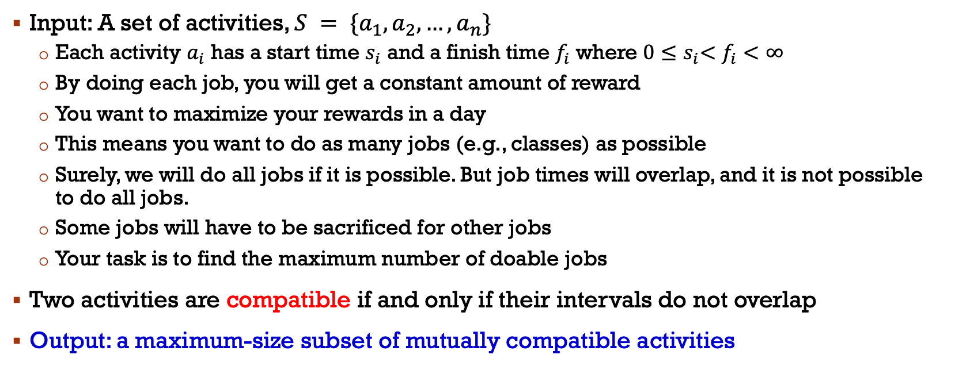
Activity Scheduling Problem
Input: A set of activities, $S = \{a_{1},a_{2},…,a_{n}\}$
Each activity $a_{i}$ has a start time $s_{i}$ and a finish time $f_{i}$ where $0{≤s}_{i}<f_{i}<∞$
By doing each job, you will get a constant amount of reward
You want to maximize your rewards in a day
This means you want to do as many jobs (e.g., classes) as possible
Surely, we will do all jobs if it is possible. But job times will overlap, and it is not possible to do all jobs.
Some jobs will have to be sacrificed for other jobs
Your task is to find the maximum number of doable jobs
Two activities are compatible if and only if their intervals do not overlap
Output: a maximum-size subset of mutually compatible activities

Slide 5
Activity Scheduling Problem
The greedy choice can be applied to find solutions (the maximum number of activities that can be performed) by using
earliest finish time
earliest start time
shortest interval
Always gives optimal solution
Does not always give optimal solution
Does not always give optimal solution

Slide 6
Activity Scheduling: Early Finish Time
Select the activity with the earliest finish time from the consideration list
Eliminate the activity from consideration list
Eliminate all non-compatible activities from the consideration list
Repeat unless the consideration list is empty

Slide 7
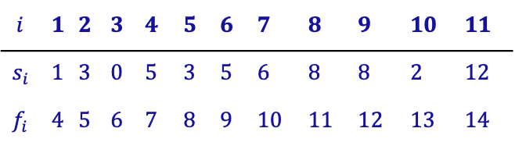

Activity Scheduling Problem
11 10 9 8 7 6 5 4 3 2 1
$$i$$ | 1 | 2 | 3 | 4 | 5 | 6 | 7 | 8 | 9 | 10 | 11
$$s_{i}$$ | 1 | 3 | 0 | 5 | 3 | 5 | 6 | 8 | 8 | 2 | 12
$$f_{i}$$ | 4 | 5 | 6 | 7 | 8 | 9 | 10 | 11 | 12 | 13 | 14

Slide 8

Activity Scheduling Problem
11 10 9 8 7 6 5 4 3 2 1
$$i$$ | 1 | 2 | 3 | 4 | 5 | 6 | 7 | 8 | 9 | 10 | 11
$$s_{i}$$ | 1 | 3 | 0 | 5 | 3 | 5 | 6 | 8 | 8 | 2 | 12
$$f_{i}$$ | 4 | 5 | 6 | 7 | 8 | 9 | 10 | 11 | 12 | 13 | 14
$$A=\{a_{1}, a_{4},a_{8},a_{11}\}$$

Slide 9
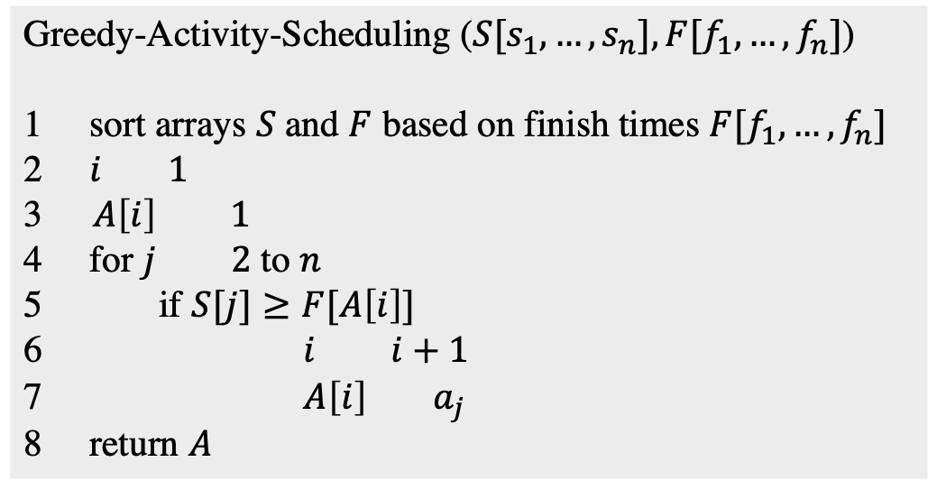
Activity Scheduling: Early Finish Time
Greedy-Activity-Scheduling ($S[s_{1},…,s_{n}], F[f_{1},…,f_{n}]$)
1 sort arrays $S$and $F$ based on finish times $F[f_{1},…,f_{n}]$
2 $i 1$
3 $A\left[i\right] 1$
4 for $j 2$ to $n$
5 if $S[j]≥F[A\left[i\right]]$
6 $i i+1$
7 $A\left[i\right] { a}_{j}$
8 return $A$
Running time is $O(nlogn)$ → from sorting operation

Slide 10
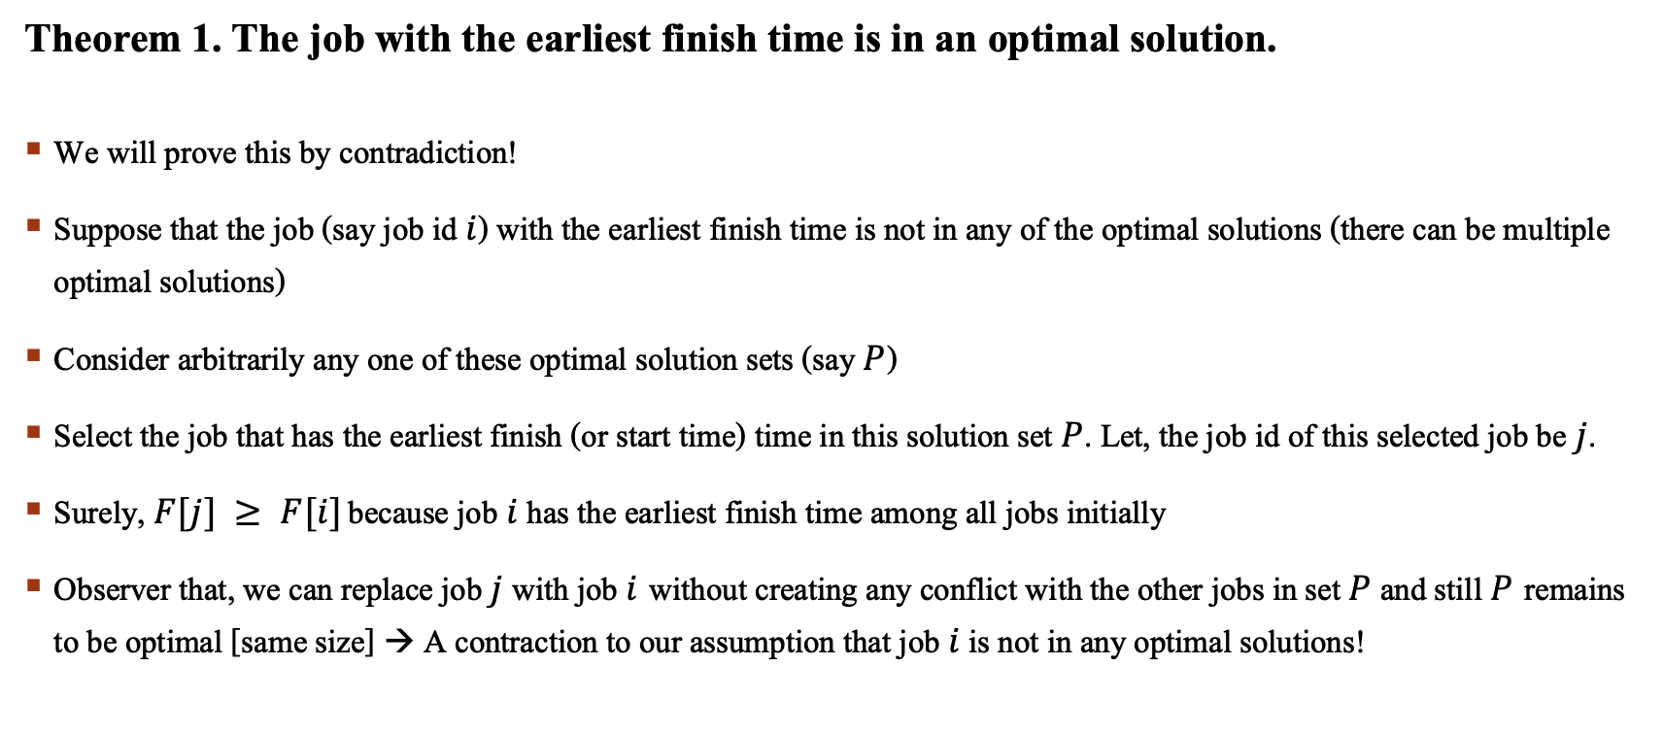
Activity Scheduling: Early Finish Time
Theorem 1. The job with the earliest finish time is in an optimal solution.
We will prove this by contradiction!
Suppose that the job (say job id $i$) with the earliest finish time is not in any of the optimal solutions (there can be multiple optimal solutions)
Consider arbitrarily any one of these optimal solution sets (say $P$)
Select the job that has the earliest finish (or start time) time in this solution set $P$. Let, the job id of this selected job be $j$.
Surely, $F[j] ≥ F[i]$ because job $i$ has the earliest finish time among all jobs initially
Observer that, we can replace job $j$ with job $i$without creating any conflict with the other jobs in set $P$ and still $P$remains to be optimal [same size] → A contraction to our assumption that job $i$ is not in any optimal solutions!

Slide 11
Activity Scheduling: Early Finish Time
Prove that Greedy-Activity-Scheduling generate an optimal solution.
According theorem 1, we select the first job since it is in optimal solution.
Then, we remove all conflicting jobs from the job set.
The original problem is then transformed to a similar problem of smaller size.
So, we continue selecting jobs following theorem 1 and we always remain optimal.

Slide 12
The famous knapsack problem
A thief breaks into a museum. Fabulous paintings, sculptures, and jewels are everywhere. The thief has a good eye for the value of these objects and knows that each will fetch hundreds or thousands of dollars on the clandestine art collector’s market. But the thief has only brought a single knapsack to the scene of the robbery and can take away only what he can carry. What items should the thief take to maximize the haul?
Which items should I take?

Slide 13
The famous knapsack problem
There are two versions of the problem:
(1) “0-1 knapsack problem”
Items are indivisible: you either take an item or not.
Solved with dynamic programming.
(2) “Fractional knapsack problem”
Items are divisible: you can take any fraction of an item.
Solved with a greedy algorithm.

Slide 14
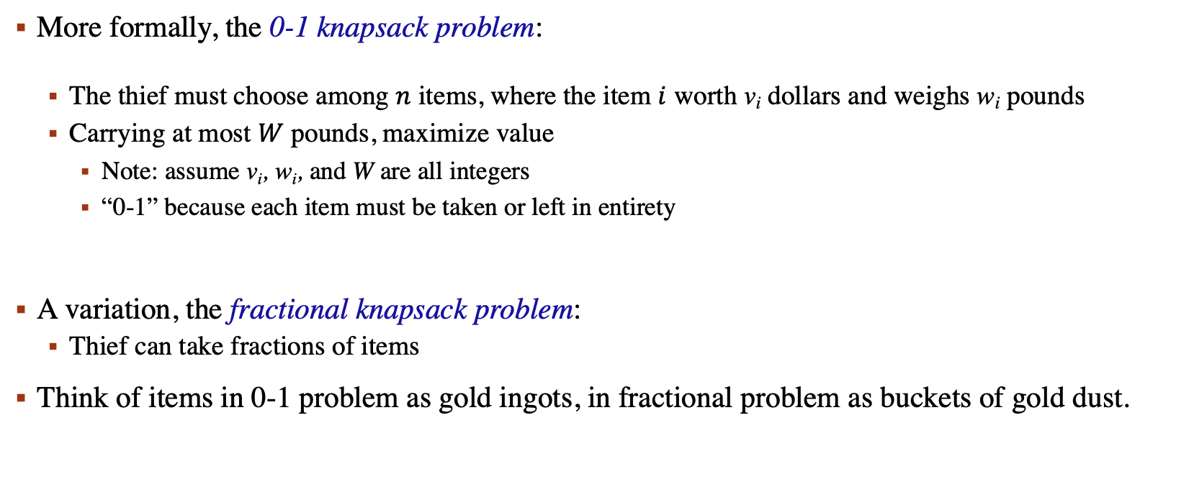
The famous knapsack problem
More formally, the 0-1 knapsack problem:
The thief must choose among $n$ items, where the item $i$ worth v_{i} dollars and weighs w_{i} pounds
Carrying at most $W$ pounds, maximize value
Note: assume v_{i}, w_{i}, and W are all integers
“0-1” because each item must be taken or left in entirety
A variation, the fractional knapsack problem:
Thief can take fractions of items
Think of items in 0-1 problem as gold ingots, in fractional problem as buckets of gold dust.

Slide 15

Fractional Knapsack problem
Knapsack capacity: $W$
There are $n$ items: item $i$ has a value of $v_{i}$ and wight $w_{i}$
Goal:
Find $x_{i}$ such that for all $0≤x_{i}≤1, i=1, 2, …, n$
$Σ$ $w_{i}x_{i}≤W$
$Σ$ $x_{i}v_{i}$ is maximum

Slide 16
Fractional Knapsack problem
Greedy strategy:
Pick the item with the maximum value per pound v_{i}/w_{i}
If the supply of that element is exhausted and the thief can carry more: take as much as possible from the item with the next greatest value per pound
It is good to order items based on their value per pound

Slide 17
Fractional Knapsack problem
50
Item 3
Item i | Weight (w_{i}) | Value (v_{i}) | v_{i}/w_{i} | Fraction (x_{i})
1 | 10 | 60 | 6
2 | 20 | 100 | 5
3 | 30 | 120 | 4
Item 2
30
Item 1
20
10
$60
$100
$120
$6/pound
$5/pound
$4/pound

Slide 18
Fractional Knapsack problem
50
50
Item 3
Item i | Weight (w_{i}) | Value (v_{i}) | v_{i}/w_{i} | Fraction (x_{i})
1 | 10 | 60 | 6
2 | 20 | 100 | 5
3 | 30 | 120 | 4
Item 2
30
Item 1
20
10
$60
$100
$120
$6/pound
$5/pound
$4/pound

Slide 19
Fractional Knapsack problem
50
40
Item 3
Item i | Weight (w_{i}) | Value (v_{i}) | v_{i}/w_{i} | Fraction (x_{i})
1 | 10 | 60 | 6 | 1
2 | 20 | 100 | 5
3 | 30 | 120 | 4
Item 2
30
Item 1
20
10
10
$60
$60
$100
$120
$60
$6/pound
$5/pound
$4/pound

Slide 20
Fractional Knapsack problem
50
40
Item 3
Item i | Weight (w_{i}) | Value (v_{i}) | v_{i}/w_{i} | Fraction (x_{i})
1 | 10 | 60 | 6 | 1
2 | 20 | 100 | 5
3 | 30 | 120 | 4
Item 2
30
20
10
$60
$100
$120
$60
$5/pound
$4/pound

Slide 21
Fractional Knapsack problem
50
50
20
Item 3
Item i | Weight (w_{i}) | Value (v_{i}) | v_{i}/w_{i} | Fraction (x_{i})
1 | 10 | 60 | 6 | 1
2 | 20 | 100 | 5 | 1
3 | 30 | 120 | 4
Item 2
30
20
$100
+
20
10
$60
$100
$120
$160
$5/pound
$4/pound

Slide 22
Fractional Knapsack problem
50
50
20
Item 3
Item i | Weight (w_{i}) | Value (v_{i}) | v_{i}/w_{i} | Fraction (x_{i})
1 | 10 | 60 | 6 | 1
2 | 20 | 100 | 5 | 1
3 | 30 | 120 | 4
30
20
$100
+
10
$60
$120
$160
$4/pound

Slide 23
Fractional Knapsack problem
50
50
20
Item 3
Item i | Weight (w_{i}) | Value (v_{i}) | v_{i}/w_{i} | Fraction (x_{i})
1 | 10 | 60 | 6 | 1
2 | 20 | 100 | 5 | 1
3 | 30 | 120 | 4 | 2/3
30
20
$100
+
10
$60
$120
$160
$4/pound

Slide 24
Fractional Knapsack problem
50
20
30
50
20
$80
+
Item 3
Item i | Weight (w_{i}) | Value (v_{i}) | v_{i}/w_{i} | Fraction (x_{i})
1 | 10 | 60 | 6 | 1
2 | 20 | 100 | 5 | 1
3 | 30 | 120 | 4 | 2/3
20
$100
+
10
10
$60
$120
$240
$4/pound

Slide 25
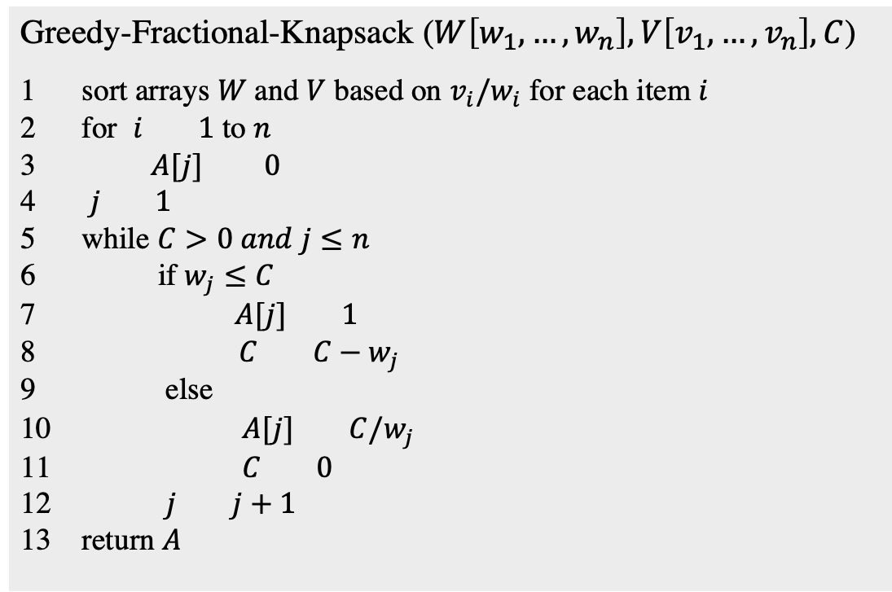
Fractional Knapsack problem
Greedy-Fractional-Knapsack ($W\left[w_{1},…,w_{n}\right], V\left[v_{1},…,v_{n}\right], C$)
sort arrays $W$and $V$ based on $v_{i}/w_{i}$ for each item $i$
for $i 1$ to $n$
$A[j] 0$
$j 1$
while $C>0 and j≤n$
if $w_{j}≤C$
$A[j] 1$
$C C−w_{j}$
else
$A[j] C/w_{j}$
$C 0$
$j j+1$
return $A$
Running time is $O(nlogn)$ → from sorting operation

Slide 26
Let’s get back a bit to Graph Theory

Slide 27
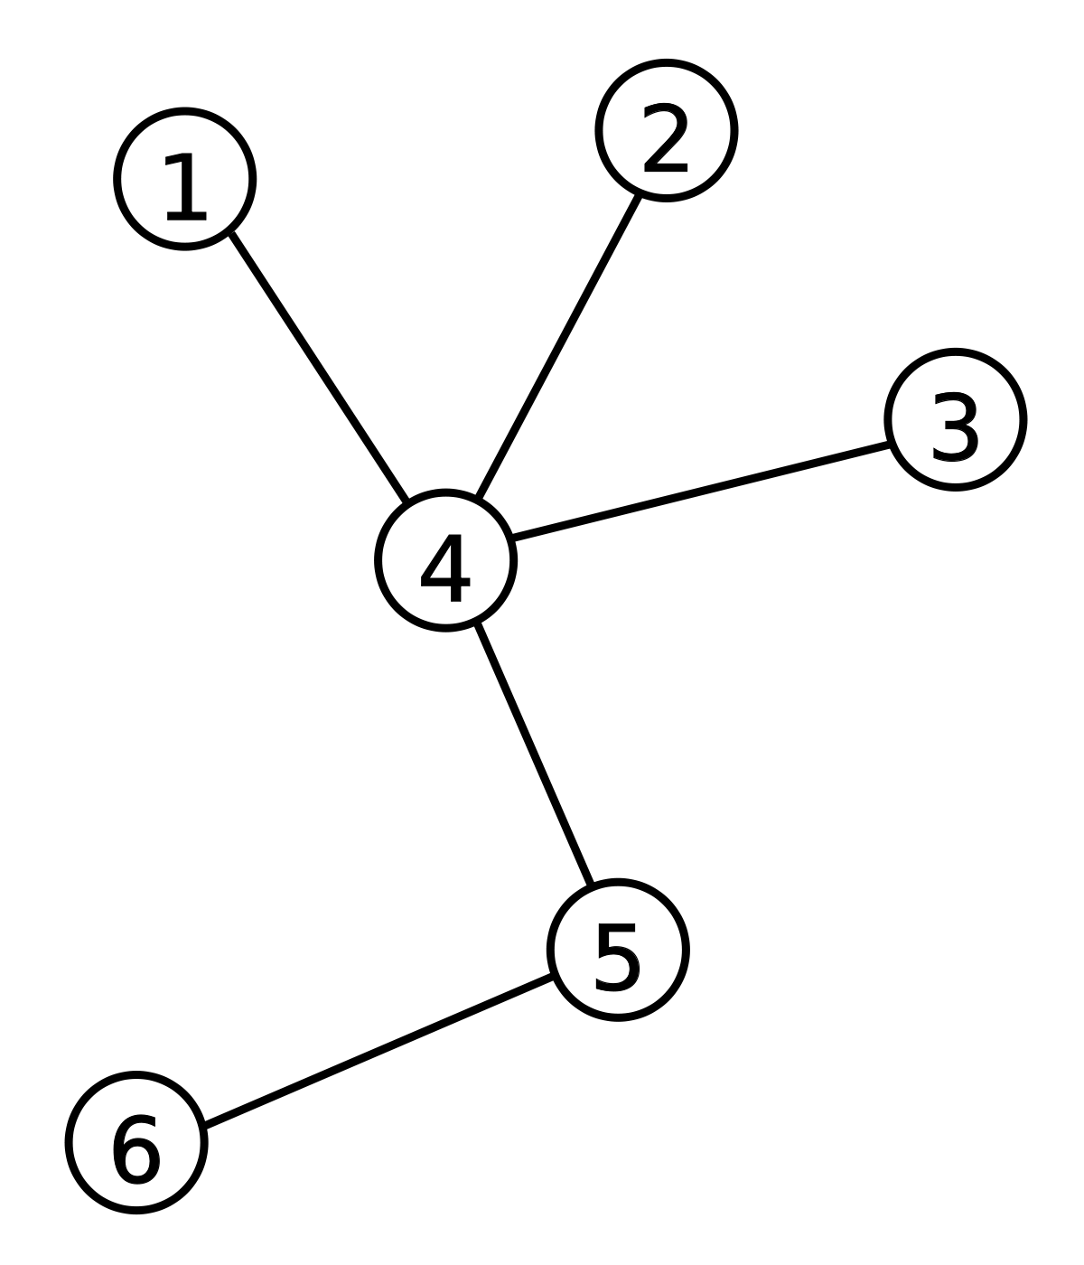

Trees and Forests
Tree
undirected, connected and acyclic graph
a connected graph that does not contain any single cycle is called a tree
vertices of trees are called their nodes and the edges of the tree are called branches
a tree with $n$ vertices has ($n−1$) edges
leaf in a tree is a vertex of degree $1$

Slide 28
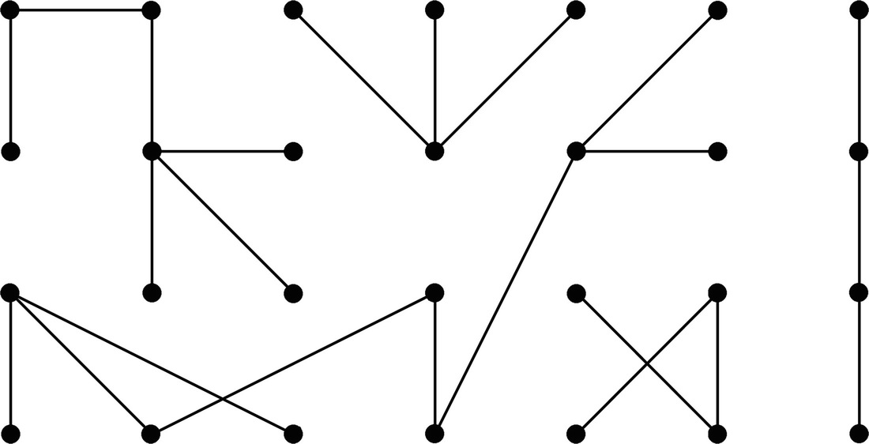
Trees and Forests
Forest
undirected, disconnected and acyclic graph
collection of disjoint trees

Slide 29
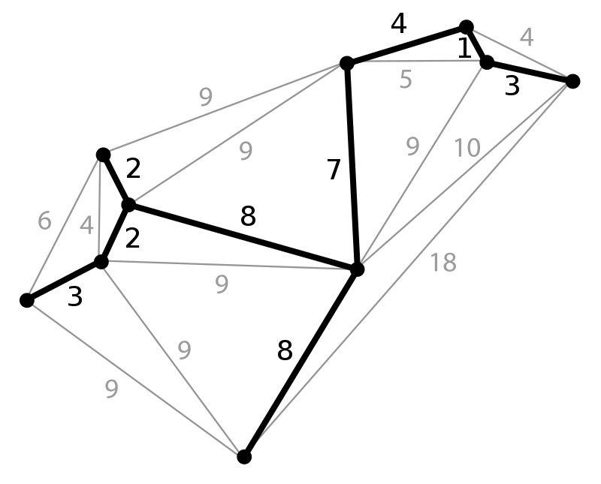
Spanning Tree
Given an undirected and connected graph G = (V, E). A spanning tree of the graph G is a tree that spans G (includes every vertex of G) and is a subgraph of G (every edge in the tree belongs to G)

Slide 30
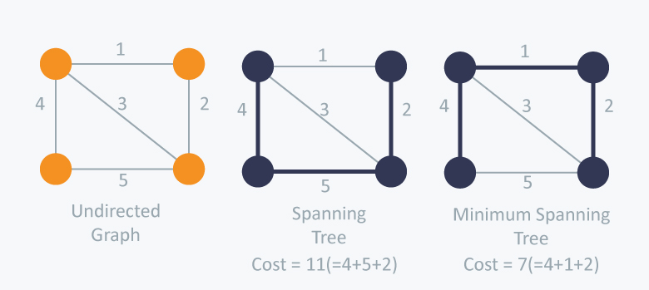
Minimum Spanning Tree
A graph can have multiple spanning trees
The cost of the spanning tree is the sum of the weights of all the edges in the tree
Minimum spanning tree is the spanning tree where the cost is minimum among all the spanning trees
There also can be many minimum spanning trees

Slide 31
FINDING MINIMUM spanning tree
Use greedy techniques
Food for thought
8
7
1
2
3
4
9
2
0
11
8
4
14
4
7
6
8
10
7
6
5
1
2

Slide 32
FINDING mst: Kruskal’s algorithm
weight | source | dest
1 | 7 | 6
2 | 8 | 2
2 | 6 | 5
4 | 0 | 1
4 | 2 | 5
6 | 8 | 6
7 | 2 | 3
7 | 7 | 8
8 | 0 | 7
8 | 1 | 2
9 | 3 | 4
10 | 5 | 4
11 | 1 | 7
14 | 3 | 5
8
7
1
2
3
4
9
2
0
11
8
4
14
4
7
6
8
10
7
6
5
1
2

Slide 33
FINDING mst: Kruskal’s algorithm
weight | source | dest
1 | 7 | 6
2 | 8 | 2
2 | 6 | 5
4 | 0 | 1
4 | 2 | 5
6 | 8 | 6
7 | 2 | 3
7 | 7 | 8
8 | 0 | 7
8 | 1 | 2
9 | 3 | 4
10 | 5 | 4
11 | 1 | 7
14 | 3 | 5
8
7
1
2
3
4
9
2
0
11
8
4
14
4
7
6
8
10
7
6
5
1
2

Slide 34
FINDING mst: Kruskal’s algorithm
weight | source | dest
1 | 7 | 6
2 | 8 | 2
2 | 6 | 5
4 | 0 | 1
4 | 2 | 5
6 | 8 | 6
7 | 2 | 3
7 | 7 | 8
8 | 0 | 7
8 | 1 | 2
9 | 3 | 4
10 | 5 | 4
11 | 1 | 7
14 | 3 | 5
8
7
1
2
3
4
9
2
0
11
8
4
14
4
7
6
8
10
7
6
5
1
2

Slide 35
FINDING mst: Kruskal’s algorithm
weight | source | dest
1 | 7 | 6
2 | 8 | 2
2 | 6 | 5
4 | 0 | 1
4 | 2 | 5
6 | 8 | 6
7 | 2 | 3
7 | 7 | 8
8 | 0 | 7
8 | 1 | 2
9 | 3 | 4
10 | 5 | 4
11 | 1 | 7
14 | 3 | 5
8
7
1
2
3
4
9
2
0
11
8
4
14
4
7
6
8
10
7
6
5
1
2

Slide 36
FINDING mst: Kruskal’s algorithm
weight | source | dest
1 | 7 | 6
2 | 8 | 2
2 | 6 | 5
4 | 0 | 1
4 | 2 | 5
6 | 8 | 6
7 | 2 | 3
7 | 7 | 8
8 | 0 | 7
8 | 1 | 2
9 | 3 | 4
10 | 5 | 4
11 | 1 | 7
14 | 3 | 5
8
7
1
2
3
4
9
2
0
11
8
4
14
4
7
6
8
10
7
6
5
1
2

Slide 37
FINDING mst: Kruskal’s algorithm
weight | source | dest
1 | 7 | 6
2 | 8 | 2
2 | 6 | 5
4 | 0 | 1
4 | 2 | 5
6 | 8 | 6
7 | 2 | 3
7 | 7 | 8
8 | 0 | 7
8 | 1 | 2
9 | 3 | 4
10 | 5 | 4
11 | 1 | 7
14 | 3 | 5
8
7
1
2
3
4
9
2
0
11
8
4
14
4
7
6
8
10
7
6
5
1
2

Slide 38
FINDING mst: Kruskal’s algorithm
weight | source | dest
1 | 7 | 6
2 | 8 | 2
2 | 6 | 5
4 | 0 | 1
4 | 2 | 5
6 | 8 | 6
7 | 2 | 3
7 | 7 | 8
8 | 0 | 7
8 | 1 | 2
9 | 3 | 4
10 | 5 | 4
11 | 1 | 7
14 | 3 | 5
8
7
1
2
3
4
9
2
0
11
8
4
14
4
7
6
8
10
7
6
5
1
2

Slide 39
FINDING mst: Kruskal’s algorithm
weight | source | dest
1 | 7 | 6
2 | 8 | 2
2 | 6 | 5
4 | 0 | 1
4 | 2 | 5
6 | 8 | 6
7 | 2 | 3
7 | 7 | 8
8 | 0 | 7
8 | 1 | 2
9 | 3 | 4
10 | 5 | 4
11 | 1 | 7
14 | 3 | 5
8
7
1
2
3
4
9
2
0
11
8
4
14
4
7
6
8
10
7
6
5
1
2

Slide 40
FINDING mst: Kruskal’s algorithm
weight | source | dest
1 | 7 | 6
2 | 8 | 2
2 | 6 | 5
4 | 0 | 1
4 | 2 | 5
6 | 8 | 6
7 | 2 | 3
7 | 7 | 8
8 | 0 | 7
8 | 1 | 2
9 | 3 | 4
10 | 5 | 4
11 | 1 | 7
14 | 3 | 5
8
7
1
2
3
4
9
2
0
11
8
4
14
4
7
8
10
7
6
5
1
2

Slide 41
FINDING mst: Kruskal’s algorithm
weight | source | dest
1 | 7 | 6
2 | 8 | 2
2 | 6 | 5
4 | 0 | 1
4 | 2 | 5
6 | 8 | 6
7 | 2 | 3
7 | 7 | 8
8 | 0 | 7
8 | 1 | 2
9 | 3 | 4
10 | 5 | 4
11 | 1 | 7
14 | 3 | 5
8
7
1
2
3
4
9
2
0
11
8
4
14
4
7
8
10
7
6
5
1
2

Slide 42
FINDING mst: Kruskal’s algorithm
weight | source | dest
1 | 7 | 6
2 | 8 | 2
2 | 6 | 5
4 | 0 | 1
4 | 2 | 5
6 | 8 | 6
7 | 2 | 3
7 | 7 | 8
8 | 0 | 7
8 | 1 | 2
9 | 3 | 4
10 | 5 | 4
11 | 1 | 7
14 | 3 | 5
8
7
1
2
3
4
9
2
0
11
8
4
14
4
7
8
10
7
6
5
1
2

Slide 43
FINDING mst: Kruskal’s algorithm
weight | source | dest
1 | 7 | 6
2 | 8 | 2
2 | 6 | 5
4 | 0 | 1
4 | 2 | 5
6 | 8 | 6
7 | 2 | 3
7 | 7 | 8
8 | 0 | 7
8 | 1 | 2
9 | 3 | 4
10 | 5 | 4
11 | 1 | 7
14 | 3 | 5
8
7
1
2
3
4
9
2
0
11
8
4
14
4
8
10
7
6
5
1
2

Slide 44
FINDING mst: Kruskal’s algorithm
weight | source | dest
1 | 7 | 6
2 | 8 | 2
2 | 6 | 5
4 | 0 | 1
4 | 2 | 5
6 | 8 | 6
7 | 2 | 3
7 | 7 | 8
8 | 0 | 7
8 | 1 | 2
9 | 3 | 4
10 | 5 | 4
11 | 1 | 7
14 | 3 | 5
8
7
1
2
3
4
9
2
0
11
8
4
14
4
8
10
7
6
5
1
2

Slide 45
FINDING mst: Kruskal’s algorithm
weight | source | dest
1 | 7 | 6
2 | 8 | 2
2 | 6 | 5
4 | 0 | 1
4 | 2 | 5
6 | 8 | 6
7 | 2 | 3
7 | 7 | 8
8 | 0 | 7
8 | 1 | 2
9 | 3 | 4
10 | 5 | 4
11 | 1 | 7
14 | 3 | 5
7
1
2
3
4
9
2
0
11
8
4
14
4
8
10
7
6
5
1
2

Slide 46
FINDING mst: Kruskal’s algorithm
weight | source | dest
1 | 7 | 6
2 | 8 | 2
2 | 6 | 5
4 | 0 | 1
4 | 2 | 5
6 | 8 | 6
7 | 2 | 3
7 | 7 | 8
8 | 0 | 7
8 | 1 | 2
9 | 3 | 4
10 | 5 | 4
11 | 1 | 7
14 | 3 | 5
7
1
2
3
4
9
2
0
11
8
4
14
4
8
10
7
6
5
1
2

Slide 47
FINDING mst: Kruskal’s algorithm
weight | source | dest
1 | 7 | 6
2 | 8 | 2
2 | 6 | 5
4 | 0 | 1
4 | 2 | 5
6 | 8 | 6
7 | 2 | 3
7 | 7 | 8
8 | 0 | 7
8 | 1 | 2
9 | 3 | 4
10 | 5 | 4
11 | 1 | 7
14 | 3 | 5
7
1
2
3
4
9
2
0
8
4
4
8
7
6
5
1
2
MST with cost = 37

Slide 48
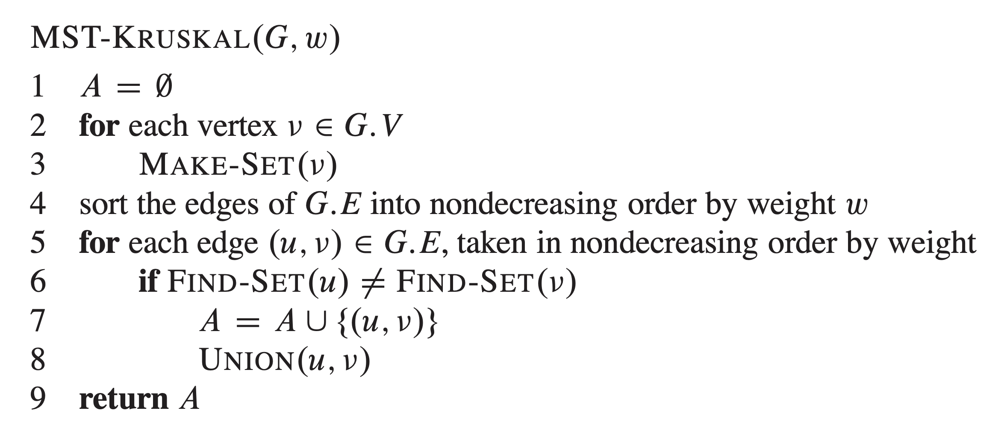
FINDING mst: Kruskal’s algorithm
8
7
1
2
3
4
9
2
0
11
8
4
14
4
7
6
8
10
7
6
5
1
2

Slide 49
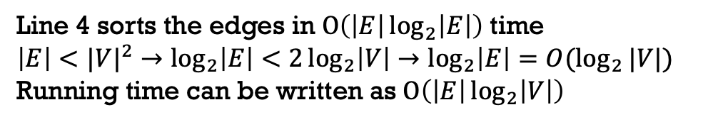
FINDING mst: Kruskal’s algorithm
8
7
1
2
3
4
9
2
Line 4 sorts the edges in $O\left(\left|E\right|\log_{2}\left|E\right|\right)$ time
$$\left|E\right|<|{V|}^{2}→\log_{2}\left|E\right|<2\log_{2}\left|V\right|→\log_{2}\left|E\right|=O(\log_{2}{|V|)}$$
Running time can be written as $O\left(\left|E\right|\log_{2}\left|V\right|\right)$
0
11
8
4
14
4
7
6
8
10
7
6
5
1
2

Slide 50
FINDING mst: PRIME’s algorithm
0,1,2,3,4,
5,6,7,8
8
7
1
2
3
4
9
2
0
11
8
4
14
4
7
6
8
10
7
6
5
1
2
unexplored
explored

Slide 51
FINDING mst: PRIME’s algorithm
1,2,3,4,
5,6,7,8
0
8
7
1
2
3
4
9
2
0
11
8
4
14
4
7
6
8
10
7
6
5
1
2
unexplored
explored

Slide 52
FINDING mst: PRIME’s algorithm
2,3,4,
5,6,7,8
0,1
8
7
1
2
3
4
9
2
0
11
8
4
14
4
7
6
8
10
7
6
5
1
2
unexplored
explored

Slide 53
FINDING mst: PRIME’s algorithm
3,4,
5,6,7,8
0,1,2
8
7
1
2
3
4
9
2
0
11
8
4
14
4
7
6
8
10
7
6
5
1
2
unexplored
explored

Slide 54
FINDING mst: PRIME’s algorithm
3,4,
5,6,7
0,1,2,8
8
7
1
2
3
4
9
2
0
11
8
4
14
4
7
6
8
10
7
6
5
1
2
unexplored
explored

Slide 55
FINDING mst: PRIME’s algorithm
3,4,
6,7
0,1,2,8,5
8
7
1
2
3
4
9
2
0
11
8
4
14
4
7
6
8
10
7
6
5
1
2
unexplored
explored

Slide 56
FINDING mst: PRIME’s algorithm
3,4,
7
0,1,2,8,5,
6
8
7
1
2
3
4
9
2
0
11
8
4
14
4
7
6
8
10
7
6
5
1
2
unexplored
explored

Slide 57
FINDING mst: PRIME’s algorithm
3,4
0,1,2,8,5,
6,7
8
7
1
2
3
4
9
2
0
11
8
4
14
4
7
6
8
10
7
6
5
1
2
unexplored
explored

Slide 58
FINDING mst: PRIME’s algorithm
3,4
0,1,2,8,5,
6,7
8
7
1
2
3
4
9
2
0
11
8
4
14
4
7
8
10
7
6
5
1
2
unexplored
explored

Slide 59
FINDING mst: PRIME’s algorithm
4
0,1,2,8,5,
6,7, 3
8
7
1
2
3
4
9
2
0
11
8
4
14
4
7
8
10
7
6
5
1
2
unexplored
explored

Slide 60
FINDING mst: PRIME’s algorithm
4
0,1,2,8,5,
6,7, 3
8
7
1
2
3
4
9
2
0
11
8
4
14
4
8
10
7
6
5
1
2
unexplored
explored

Slide 61
FINDING mst: PRIME’s algorithm
4
0,1,2,8,5,
6,7, 3
8
7
1
2
3
4
9
2
0
11
8
4
14
4
10
7
6
5
1
2
unexplored
explored

Slide 62
FINDING mst: PRIME’s algorithm
0,1,2,8,5,
6,7, 3,4
8
7
1
2
3
4
9
2
0
11
8
4
14
4
10
7
6
5
1
2
unexplored
explored

Slide 63
FINDING mst: PRIME’s algorithm
0,1,2,8,5,
6,7, 3,4
8
7
1
2
3
4
9
2
0
8
4
4
7
6
5
1
2
unexplored
explored
MST with cost = 37

Slide 64
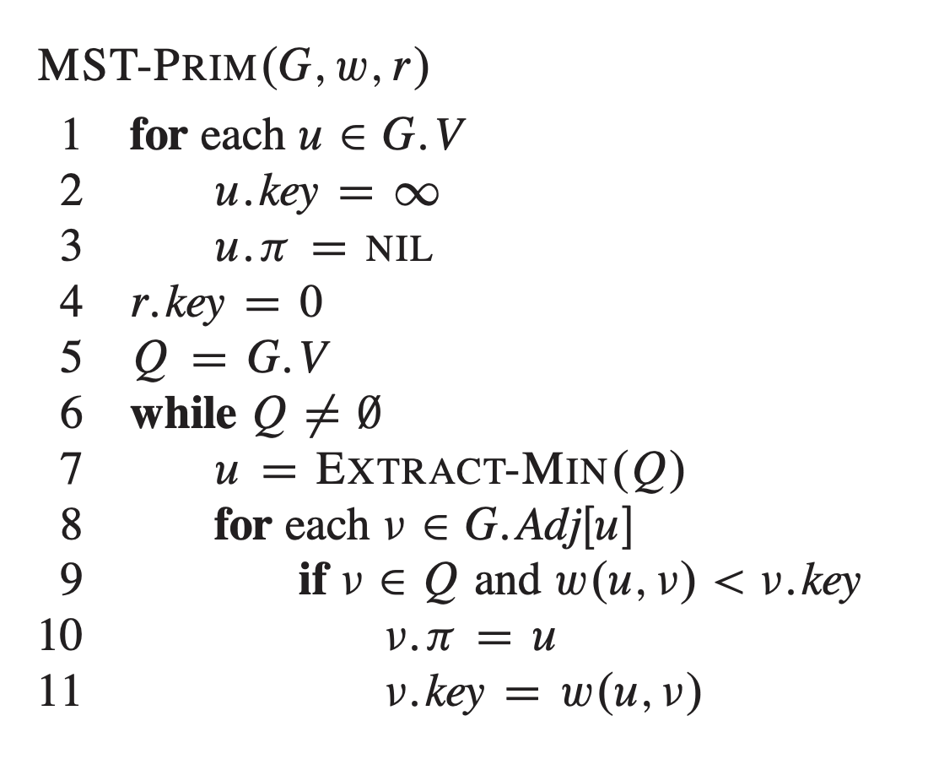
FINDING mst: PRIME’s algorithm
8
7
1
2
3
4
9
2
0
11
8
4
14
4
7
6
8
10
7
6
5
1
2

Slide 65

FINDING mst: PRIME’s algorithm
BUILD-MIN-HEAP → $O\left(V\right)$

Slide 66

FINDING mst: PRIME’s algorithm
BUILD-MIN-HEAP → $O\left(V\right)$
$|V|$ times

Slide 67
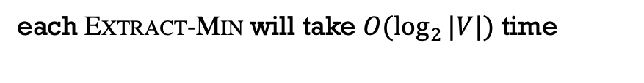
FINDING mst: PRIME’s algorithm
BUILD-MIN-HEAP → $O\left(V\right)$
$|V|$ times
each EXTRACT-MIN will take $O(\log_{2}{|V|})$ time

Slide 68

FINDING mst: PRIME’s algorithm
BUILD-MIN-HEAP → $O\left(V\right)$
$|V|$ times
$$O(\left|V\right|\log_{2}{|V|)}$$
each EXTRACT-MIN will take $O(\log_{2}{|V|})$ time

Slide 69
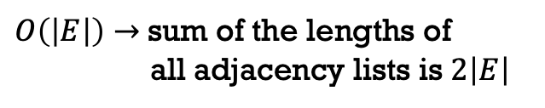
FINDING mst: PRIME’s algorithm
BUILD-MIN-HEAP → $O\left(V\right)$
$|V|$ times
$$O(\left|V\right|\log_{2}{|V|)}$$
each EXTRACT-MIN will take $O(\log_{2}{|V|})$ time
$O\left(\left|E\right|\right)→$sum of the lengths of
all adjacency lists is $2\left|E\right|$

Slide 70
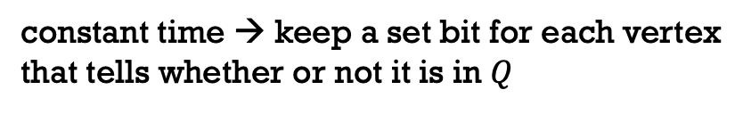

FINDING mst: PRIME’s algorithm
BUILD-MIN-HEAP → $O\left(V\right)$
$|V|$ times
$$O(\left|V\right|\log_{2}{|V|)}$$
each EXTRACT-MIN will take $O(\log_{2}{|V|})$ time
$O\left(\left|E\right|\right)→$sum of the lengths of
all adjacency lists is $2\left|E\right|$
constant time → keep a set bit for each vertex
that tells whether or not it is in $Q$
$O(log_{2}|V|)→$DECREASE-KEY operation

Slide 71

FINDING mst: PRIME’s algorithm
BUILD-MIN-HEAP → $O\left(V\right)$
$|V|$ times
$$O(\left|V\right|\log_{2}{|V|)}$$
each EXTRACT-MIN will take $O(\log_{2}{|V|})$ time
$O\left(\left|E\right|\right)→$sum of the lengths of
all adjacency lists is $2\left|E\right|$
constant time → keep a set bit for each vertex
that tells whether or not it is in $Q$
$$O\left(\left|E\right|\log_{2}{|V|}\right)$$
$O(log_{2}|V|)→$DECREASE-KEY operation

Slide 72
FINDING mst: PRIME’s algorithm
BUILD-MIN-HEAP → $O\left(V\right)$
$|V|$ times
$$O(\left|V\right|\log_{2}{|V|)}$$
each EXTRACT-MIN will take $O(\log_{2}{|V|})$ time
$O\left(\left|E\right|\right)→$sum of the lengths of
all adjacency lists is $2\left|E\right|$
constant time → keep a set bit for each vertex
that tells whether or not it is in $Q$
$$O\left(\left|E\right|\log_{2}{|V|}\right)$$
$O(log_{2}|V|)→$DECREASE-KEY operation
Overall running time $→O\left(\left|V\right|\log_{2}\left|V\right|+\left|E\right|\log_{2}\left|V\right|\right)$

Slide 73
FINDING mst: PRIME’s algorithm
BUILD-MIN-HEAP → $O\left(V\right)$
$|V|$ times
$$O(\left|V\right|\log_{2}{|V|)}$$
each EXTRACT-MIN will take $O(\log_{2}{|V|})$ time
$O\left(\left|E\right|\right)→$sum of the lengths of
all adjacency lists is $2\left|E\right|$
constant time → keep a set bit for each vertex
that tells whether or not it is in $Q$
$$O\left(\left|E\right|\log_{2}{|V|}\right)$$
$O(log_{2}|V|)→$DECREASE-KEY operation
Overall running time $→O\left(\left|V\right|\log_{2}\left|V\right|+\left|E\right|\log_{2}\left|V\right|\right)=O(\left|E\right|\log_{2}{|V|)}$

Slide 74
FINDING mst: PRIME’s algorithm
BUILD-MIN-HEAP → $O\left(V\right)$
$|V|$ times
$$O(\left|V\right|\log_{2}{|V|)}$$
each EXTRACT-MIN will take $O(\log_{2}{|V|})$ time
$O\left(\left|E\right|\right)→$sum of the lengths of
all adjacency lists is $2\left|E\right|$
constant time → keep a set bit for each vertex
that tells whether or not it is in $Q$
$$O\left(\left|E\right|\log_{2}{|V|}\right)$$
$O(log_{2}|V|)→$DECREASE-KEY operation
Overall running time $→O\left(\left|V\right|\log_{2}\left|V\right|+\left|E\right|\log_{2}\left|V\right|\right)=O(\left|E\right|\log_{2}{|V|)}$
Similar to Kruskal’s

Slide 75

FINDING mst: PRIME’s algorithm
Fibonacci-Heap
BUILD-MIN-HEAP → $O\left(V\right)$
$|V|$ times
$$O(\left|V\right|\log_{2}{|V|)}$$
each EXTRACT-MIN will take $O(\log_{2}{|V|})$ time
$O\left(\left|E\right|\right)→$sum of the lengths of
all adjacency lists is $2\left|E\right|$
constant time → keep a set bit for each vertex
that tells whether or not it is in $Q$
$O\left(1\right) amortized time→$DECREASE-KEY operation

Slide 76

FINDING mst: PRIME’s algorithm
Fibonacci-Heap
BUILD-MIN-HEAP → $O\left(V\right)$
$|V|$ times
$$O(\left|V\right|\log_{2}{|V|)}$$
each EXTRACT-MIN will take $O(\log_{2}{|V|})$ time
$O\left(\left|E\right|\right)→$sum of the lengths of
all adjacency lists is $2\left|E\right|$
constant time → keep a set bit for each vertex
that tells whether or not it is in $Q$
$$O\left(\left|E\right|\right)$$
$O\left(1\right) amortized time→$DECREASE-KEY operation

Slide 77
FINDING mst: PRIME’s algorithm
Fibonacci-Heap
BUILD-MIN-HEAP → $O\left(V\right)$
$|V|$ times
$$O(\left|V\right|\log_{2}{|V|)}$$
each EXTRACT-MIN will take $O(\log_{2}{|V|})$ time
$O\left(\left|E\right|\right)→$sum of the lengths of
all adjacency lists is $2\left|E\right|$
constant time → keep a set bit for each vertex
that tells whether or not it is in $Q$
$$O\left(\left|E\right|\right)$$
$O\left(1\right) amortized time→$DECREASE-KEY operation
Overall running time $→O\left(\left|V\right|\log_{2}\left|V\right|+\left|E\right|\right)=O(\left|E\right|+|V|\log_{2}{|V|)}$
Improved running time

Slide 78
Content Courtesy
Dr. Abul Kashem Mia, Professor, CSE, BUET
Sukarna Barua, Assistant Professor, CSE, BUET

